Slide 1
The great gatsby
By huseyın kerem mıcan

Slide 2
Presentatıon questıon
Discuss the concept of happiness in the context of The Great Gatsby. Is anybody in the novel “happy”? If so, who, and why? And if not, why are they “unhappy”?

Slide 3
ıntroductıon
The Great Gatsby is a novel that shows money can’t buy happiness. People in the novel have so much Money but still they are not happy at all. Daisy is not happy with Tom and she is in love with money and for Gatsby, money can bring him the happiness if he get her love, Daisy.

Slide 4
ın the novel nobody ıs totally happy.
I will argue that there are 4 main reasons why:
1. Gatsby had so much money but he couldn’t get Daisy.
2. Daisy was looking for something new, she was not happy with Tom.
3. Nobody had real people around them with real emotions, except Nick.
4. They thought money can buy happiness, but it couldn’t.

Slide 5
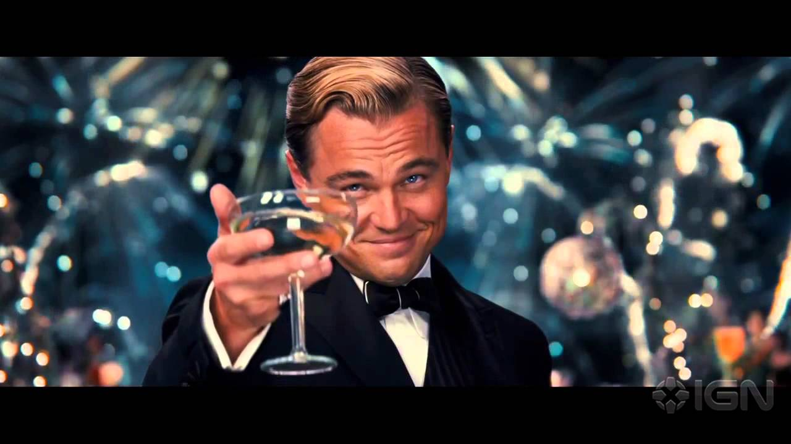
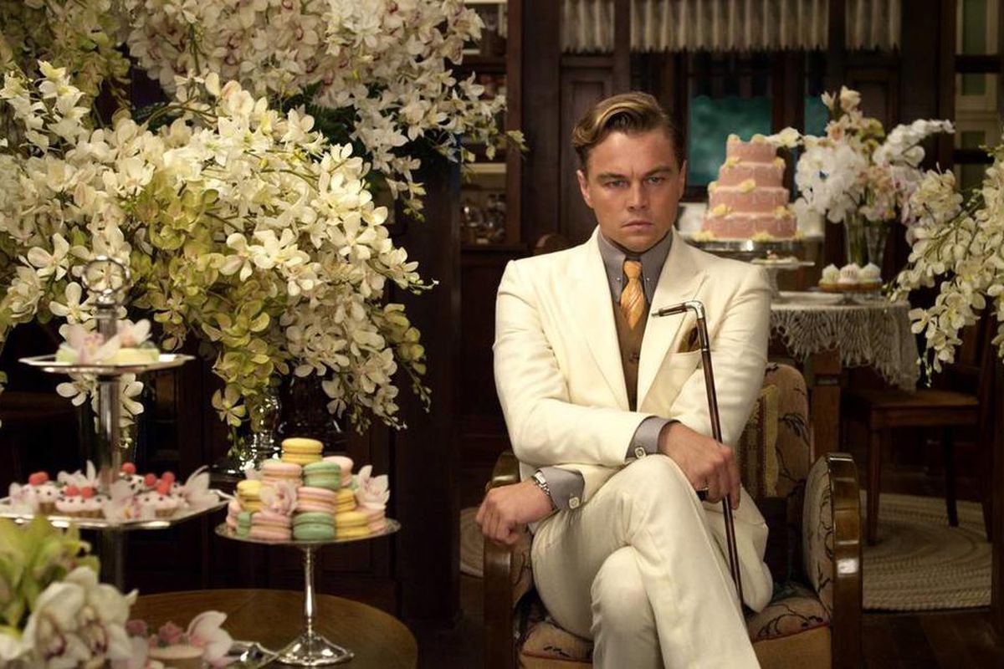
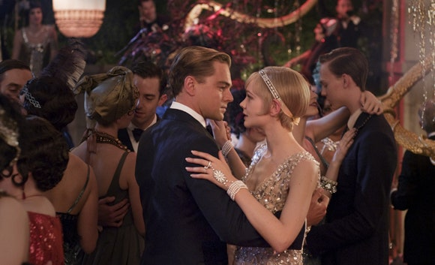
Gatsby didn’t care about the money, it was just a medium for him to reach Daisy.

Slide 6
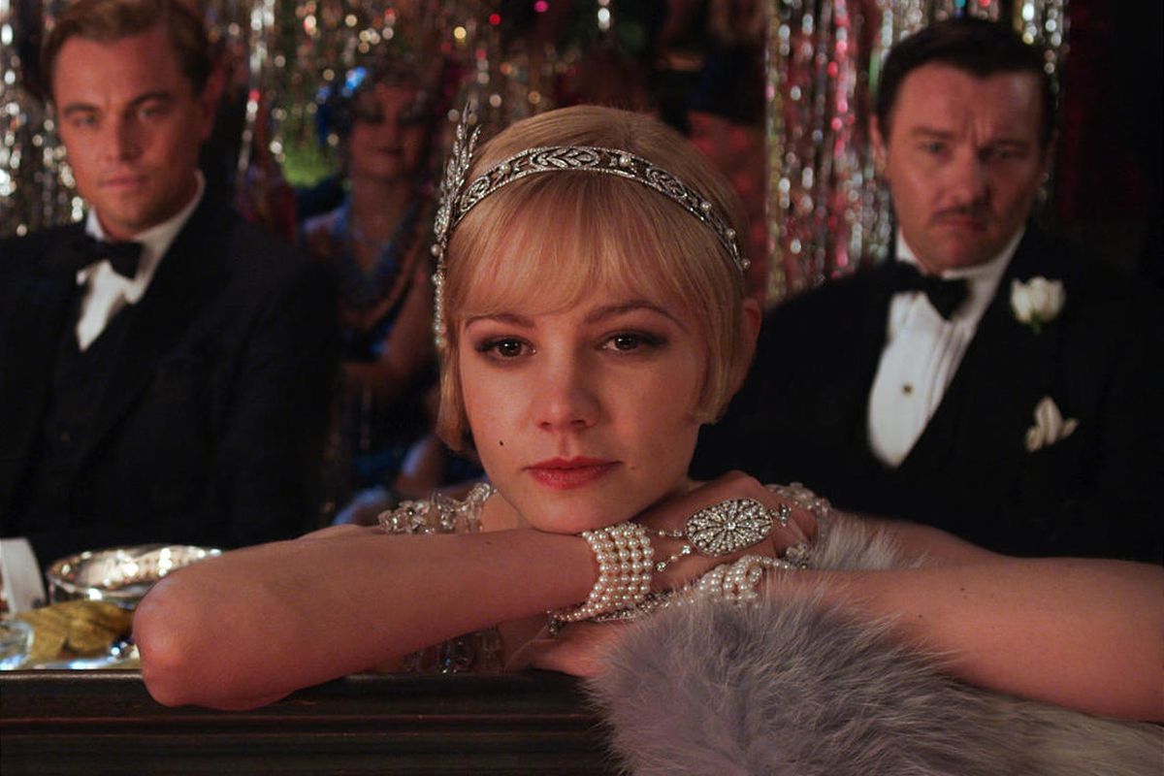
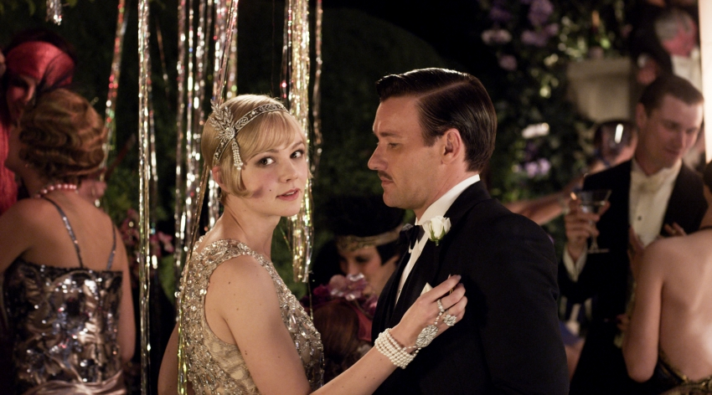
Daisy was a materialist person and she was in love with money.
She saw how rich is Gatsby and wanted to be with him and break up with Tom. But she couldn’t do that.

Slide 7
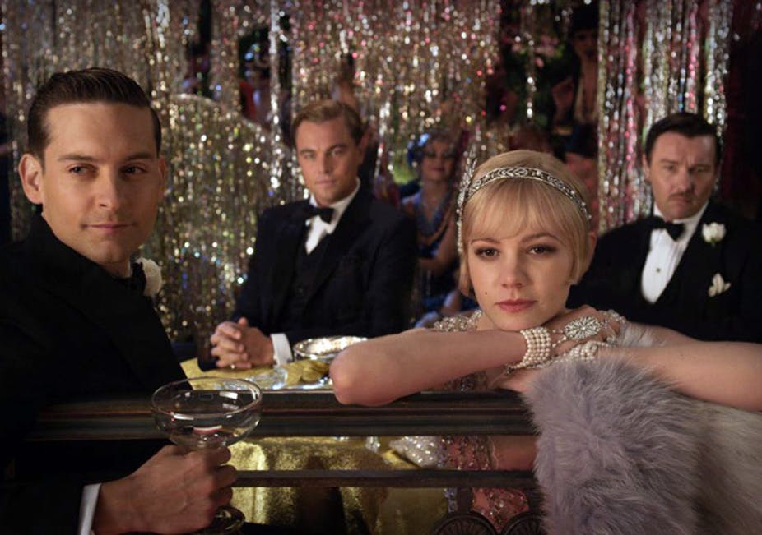
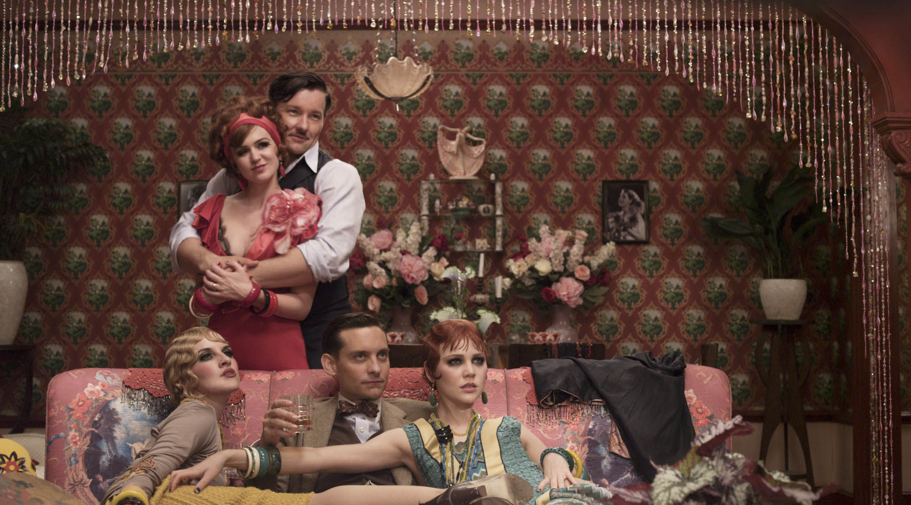
Nobody had real people around them, except the relationship between Jay Gatsby and Nick. They were real friends.
«The fidelity that Gatsby had shown to Daisy, Nick shows to Gatsby.» (Wasiolek ,1992, 20)
People just pretended that they are happy when they together, but all those things was a lie.

Slide 8
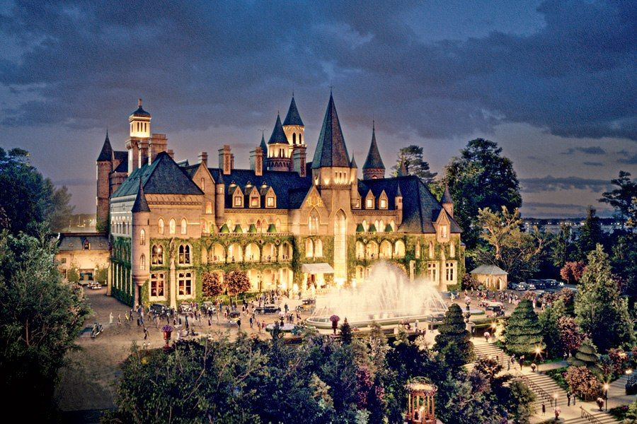
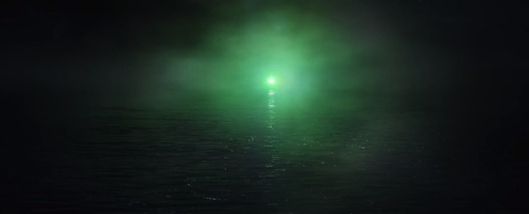
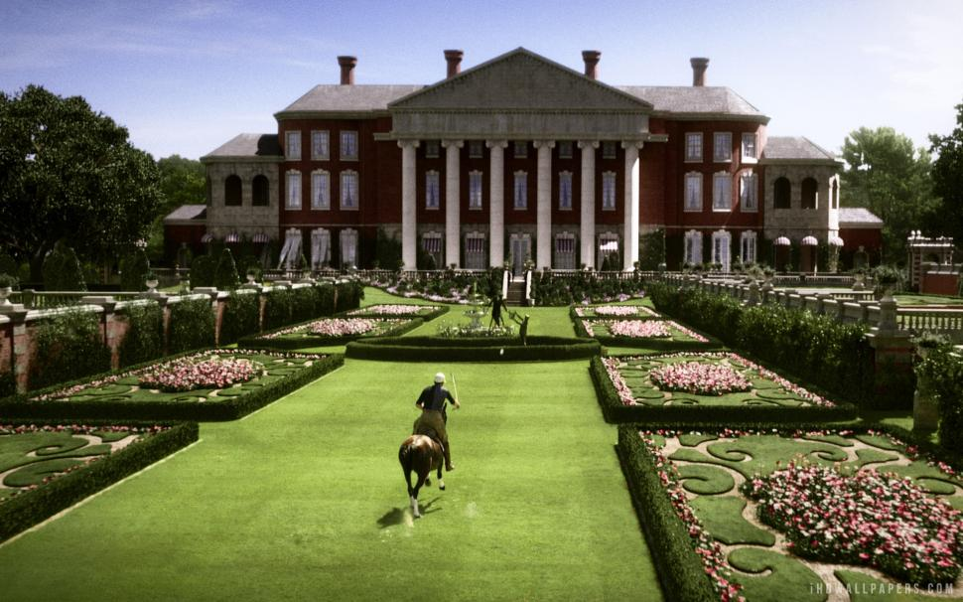
They thought money can solve their problems and buy them the happiness.
But money just brought more problems…

Slide 9
Conclusıon
Thus, it can be argued that there could be more reasons why in the novel The Great Gatsby, characters are not happy, even they have money and people around them but these things just make people unhappy and depressed. Having unreal people and so much money… Gatsby had money to reach his love but he couldn’t. Daisy was in love with money, not the person. All those people have no real friends except Gatsby and Nick. They were real friends and they could trust each other. Also they thought that money, mansions, dresses and parties can buy them happiness, but it didn’t. Because what they looking for was not money or mansions but real relationships, have people to trust.

Slide 10
References
Csikszentmihalyi, Mihaly. If we are so rich, why aren't we happy? 1999. http://ezproxy.sehir.edu.tr:5011/login.aspx?direct=true&db=edsgao&AN=edsgcl.58539926&site=eds-live (accessed April 25, 2020).
Johansson, Emma. Old Money versus New: Class Identity as a Motivational Force in The Great Gatsby. May 18, 2011. http://www.diva-portal.org/smash/get/diva2:423497/FULLTEXT03.pdf (accessed April 25, 2020).
Wasiolek, Edward. "The Sexual Drama of Nick and Gatsby." The International Fiction Review, 1992: 20.

Slide 11
Thank you for lıstenıng

